Slide 1
Test Administration and Security Guidance for Parents:
Testing at Home

Slide 2
Topics of Discussion
Purpose of Assessment
Technology requirements
Finding the test
Logins/Passwords
Best testing environment
Test security
Troubleshooting tips
Technical support

Slide 3
Purpose of Assessment
1
Notes:
It’s important for parents to understand the true purpose of the test which is to help the teacher know where the student is academically.

Slide 4
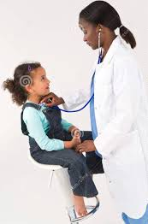
Doctor/Check-up =Teacher/Assessment
Notes:
Just like a doctor must run different tests/diagnostics to best serve their patients, teachers must use multiple measures to best serve their students. One way to do that is to assess their students using an adaptive diagnostic type assessment or universal screener. Parents can best help their child by allowing teachers to identify what students know and can do independently. Helping your child on an assessment may mean that the teacher is unable to identify areas of need. This could keep your child from getting the help he or she may need. The best help you can give on these tests is to allow your child to work independently. To help you feel comfortable with that, let’s discuss the purpose of this assessment.

Slide 5
Purpose of the Assessment
Purpose:
The entire purpose of this assessment (K-2, 3-8) is to help teachers understand where students are academically so they can make good instructional decisions.
How IS it used?
Teachers review the results for each child and plan instructional supports
based on the results.
Teachers review class results and plan instruction for the small groups or the entire class.
How is it NOT used?
The results are NOT used as grades
The score does not determine whether a student passes or fails a grade level.
The scores are not used to evaluate your child’s district, school, or teacher.
design slide)
Notes:
It’s important for parents to understand the true purpose of the test which is to help the teacher know where the student is academically which helps the teacher plan instruction.

Slide 6
How is this test different from other assessments?
NWEA Growth Assessment
This is a COMPUTER-ADAPTIVE test.
The test engine adapts based on the student’s correct or incorrect answers
Correct answer = increases difficulty of questions
Incorrect answer = decreases difficulty of questions
Not a test of mastery
The tests are intentionally designed for students to answer approximately half of the test items correctly.
Questions given are above and below the predicted academic level to determine the student’s true level.
Other Types of Assessments
Criterion-referenced - students are tested on a fixed set of items/standards.
Norm-referenced - compares a student’s performance against an average norm group.
Summative - measures knowledge at the end of a year or a semester.
Notes:
Take a minute here to fully explain how an adaptive test works - As a student correctly and incorrectly answers test items, the test is individually tailoring the skills and content each student is ready to learn. This is why students are expected to be able to correctly answer approximately half of the questions. This is why it is important for teachers to get an accurate reflection of what the student has learned and what the student’s needs truly are. (We want to help parents understand why it is important that they do not “help” their child answer questions)

Slide 7
Technology Requirements
Devices?
Operating System
Windows Desktop—Windows 7, 8.1, or 10
Macintosh—MacOS 10.12 or 10.13
iPad—iOS 9 minimum, 12 or 13
Chromebook—Google Chrome OS 65 or 78+
2
Access?
Testing Tool
Windows Desktop—https://test.mapnwea.org
Macintosh—https://test.mapnwea.org
iPad—NWEA App (Self-Service)
Chromebook—https://test.mapnwea.org
Notes:
i-Ready Technical Specs - https://cdn.i-ready.com/instruction/content/system-check/iReady_System_Requirements.pdf https://i-readycentral.com/download/?res=479&view_pdf=1
Istation - https://www.livebinders.com/play/play/2031877?tabid=dccae87e-7e41-66ec-0be1-f5e2a11cd0d3
Renaissance - http://doc.renlearn.com/KMNet/R004312127GJB43D.pdf https://p.widencdn.net/gq8g45/Family_Administering-Star-Remotely_R63030_200529 https://p.widencdn.net/cuz2g9/Star-Assessments-Guide-for-Families---At-home-administration_ESPAOL_F
NWEA - https://teach.mapnwea.org/impl/PGM2_System_Technology_Guide.pdf
https://s3-us-west-2.amazonaws.com/cdn.nwea.org/docs/MAP+Growth+Remote+Testing+-+User+Manual+(v1.2+6.23.20).pdf
Also refer to the K-2 LiveBinder tab - Testing Guidance - Fall/Winter 20/21 - scroll to the bottom for more resources per assessment

Slide 8
What do I need in order to assess my child at home ?
Digital device (not a cell phone)
Web cam (internal/external) - recommended (not required)
Microphone (internal/external) - recommended (not required)
Login and Password (Teacher will send this through Schoology)
Notes:
i-Ready Technical Specs - https://cdn.i-ready.com/instruction/content/system-check/iReady_System_Requirements.pdf https://i-readycentral.com/download/?res=479&view_pdf=1
Istation - https://www.livebinders.com/play/play/2031877?tabid=dccae87e-7e41-66ec-0be1-f5e2a11cd0d3
Renaissance - http://doc.renlearn.com/KMNet/R004312127GJB43D.pdf https://p.widencdn.net/gq8g45/Family_Administering-Star-Remotely_R63030_200529 https://p.widencdn.net/cuz2g9/Star-Assessments-Guide-for-Families---At-home-administration_ESPAOL_F
NWEA - https://teach.mapnwea.org/impl/PGM2_System_Technology_Guide.pdf
https://s3-us-west-2.amazonaws.com/cdn.nwea.org/docs/MAP+Growth+Remote+Testing+-+User+Manual+(v1.2+6.23.20).pdf
Also refer to the K-2 LiveBinder tab - Testing Guidance - Fall/Winter 20/21 - scroll to the bottom for more resources per assessment

Slide 9
Where do I find the test?
Grade K-2 students taking the MAP Growth K-2 assessment on the iPad must use the NWEA App.
If K-2 students use any other device, they may go to Classlinks and select the NWEA Growth App or they may use the standard internet browsers such as Chrome or Firefox to locate the tests at the NWEA testing webpage https://test.mapnwea.org.
Notes:
i-Ready Technical Specs - https://cdn.i-ready.com/instruction/content/system-check/iReady_System_Requirements.pdf
Istation - https://www.livebinders.com/play/play/2031877?tabid=dccae87e-7e41-66ec-0be1-f5e2a11cd0d3 https://www.istation.com/Support/FAQ
Renaissance - http://doc.renlearn.com/KMNet/R004312127GJB43D.pdf
NWEA - https://teach.mapnwea.org/impl/PGM2_System_Technology_Guide.pdf

Slide 10
Where do I find the test?
Grade 2-10 students taking MAP Growth 2-5 and MAP Growth 6+ assessments should use the standard internet browsers such as Chrome or Firefox to locate the tests at the NWEA testing webpage https://test.mapnwea.org. Do not use Internet Explorer.
Both the practice test and the actual test are found here.
For the actual test, students will have to wait for the teacher to confirm them before they can begin the test.

Slide 11
Where do I find the test?
Grade K-2 students taking the MAP Reading Fluency assessment on the iPad must use the MAP Reading Fluency Testing App. If K-2 students use any other device, they may go to Classlinks and select the MAP Reading Fluency App or they may use the standard internet browser, Chrome, to locate the tests at the MAP testing webpage https://sso.mapnwea.org/auth/studentLogin.

Slide 12
Logins and Passwords
Teachers will send communication through Schoology regarding the following:
Date and time a student will test
Log in session name and password
Microsoft Teams link to communicate with the teacher during testing
The link to take the practice test a day or two before the actual test (required for grades K-2; optional for grades 3-10) OR students may go to Classlinks and select the NWEA app to access the practice test in advance
A “Things to Do List” for before, during, and after testing
Notes:
i-Ready Technical Specs - https://cdn.i-ready.com/instruction/content/system-check/iReady_System_Requirements.pdf https://i-readycentral.com/download/?res=479&view_pdf=1
Istation - https://www.livebinders.com/play/play/2031877?tabid=dccae87e-7e41-66ec-0be1-f5e2a11cd0d3
Renaissance - http://doc.renlearn.com/KMNet/R004312127GJB43D.pdf https://p.widencdn.net/gq8g45/Family_Administering-Star-Remotely_R63030_200529 https://p.widencdn.net/cuz2g9/Star-Assessments-Guide-for-Families---At-home-administration_ESPAOL_F
NWEA - https://teach.mapnwea.org/impl/PGM2_System_Technology_Guide.pdf
https://s3-us-west-2.amazonaws.com/cdn.nwea.org/docs/MAP+Growth+Remote+Testing+-+User+Manual+(v1.2+6.23.20).pdf
Also refer to the K-2 LiveBinder tab - Testing Guidance - Fall/Winter 20/21 - scroll to the bottom for more resources per assessment

Slide 13
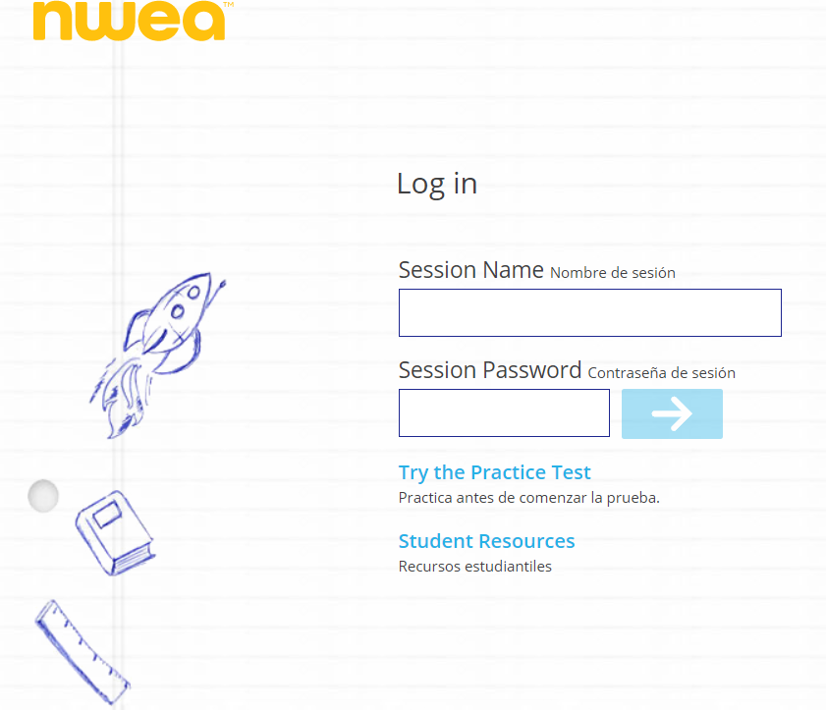
Log-in and Log-off
Logging in to the test site:
Teachers will send the Session Name and Password through Schoology and your student will use the previously mentioned ways to get to the login page for the test. Here, I entered the website address https://test.mapnwea.org
to get to the login page.
Practice are available, too.
Practice Test login:
User name—grow
Password—grow
Notes:
Optional slide - may not be needed with instructions from slide 9.
i-Ready - https://www.livebinders.com/play/play/2031877?tabid=d92c76b4-6c2a-6e65-31f8-c7a2bbd68855
Istation - https://adesandbox.arkansas.gov/file?v=ZWUwOTA3NmEwYzg2Y2E0MzNiYTYzZmViMWZmMWNlOWE.pdf&option=view

Slide 14
Troubleshooting Tips
You will receive a Q&A document in Schoology from your child’s teacher. This document will have A Remote Testing Troubleshooting Guide link attached.
Submit a question or concern in the Incident IQ app in Classlinks.
Notes:
i-Ready helpful resources - https://www.livebinders.com/play/play/2031877?tabid=d92c76b4-6c2a-6e65-31f8-c7a2bbd68855
Istation - https://www.istation.com/Contact
NWEA - https://community.nwea.org/community/nwea-community-home/covid-19-school-closure-support
Renaissance - https://www.renaissance.com/services/parent-resources/

Slide 15
Technical Support
Before the assessment:
Contact the teacher via Schoology with questions or concerns
In Classlinks, submit a question or concern in the Incident IQ app.
Submit questions to the District via a survey link that will be sent.
During the assessment:
Contact the teacher via Schoology with questions or concerns
In Classlinks, submit a question or concern in the Incident IQ app.
Submit questions to the District via a survey link that will be sent.
After the assessment:
Contact the teacher via Schoology with questions or concerns
In Classlinks, submit a question or concern in the Incident IQ app.
Submit questions to the District via a survey link that will be sent.
Notes:
In general, vendors do not provide direct support to parents. Vendors provide support to districts; districts provide support to parents. How will your district provide support before, during, and after the assessment?
Per the Ready for Learning document (pg 21) -Appoint family technology liaisons to support communication regarding the use of technology (the existing parent organization may be able to fulfill this role). This may extend beyond technology staff and can include media specialists, student technology support teams, and other members of the community.
Curriculum Associates - https://www.curriculumassociates.com/teaching-learning-2020/home-assessment-family-support?utm_source=VanityURL_IRE-649741&utm_medium=WordofMouth_Multi-use&utm_content=iready_FAMILIESASSESSATHOME&utm_campaign=vanity
Istation - https://community.nwea.org/community/nwea-community-home/covid-19-school-closure-support
NWEA - https://s3-us-west-2.amazonaws.com/cdn.nwea.org/docs/MAP+Growth+Remote+Testing+-+User+Manual+(v1.2+6.23.20).pdf

Slide 16
Best Testing Environment
Physically Ready
Research tells us that students perform better after a good night’s rest and a good breakfast.
Emotionally Ready
A student who is less anxious will always perform better academically.
Quiet Area
Students should have a quiet area away from noise and distractions such as the TV. Good Lighting
Make sure the student has a well-lit area. Check the computer brightness and for glares on the computer screen.
Comfortable Seating
Most students perform their best when seated at a table with an appropriately sized chair.
Morning/Early Afternoon
Research tells us students perform better academically in the morning or early afternoon.

Slide 17
Easing Test Anxiety
Test Anxiety:
Physical symptoms and emotional reactions that interfere with your student’s ability to perform well on tests
Have a conversation
Explain the purpose of the test.
Tell the student that he/she is NOT expected to know the all of the answers
Assure the student that it is not used for a grade.
Prepare the device the day before the assessment
Is the testing app downloaded or the website bookmarked and ready to go?
Does your student know how to access the test?
Do you have log-in and password information?
design slide)

Slide 18
Test Security
What?
Why?

Slide 19
Test Security
What is test security?
Protecting and maintaining the contents of the assessment.
Why is test security important?
Protecting and maintaining the contents of the assessment allows the results to be valid and trusted.
Valid results allow teachers to make the best instructional decisions possible for their students.

Slide 20
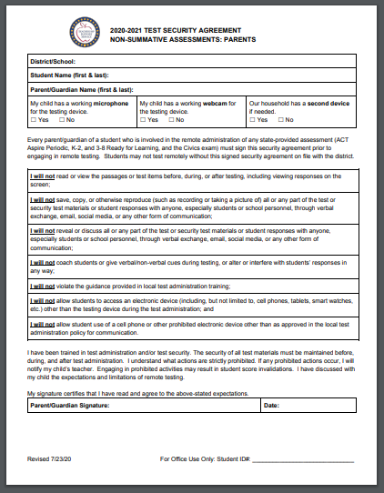
Test Security Agreement
What is the purpose of the test security agreement?
To provide information to the parent/guardian regarding general testing expectations.
A list of actions for parents to follow in order to protect the security of the assessment and the integrity of your child’s test results.
This goes back to the purpose of the assessment--that it is being used as an instructional tool for teachers.
Notes:
Link for Remote Testing - Test Security Agreement
Each district may decide how to provide the remote test security agreement. (digital signature, back to school parent packet, etc)
Each district should keep a record of all security agreements on file.
Help parents to understand that telling the child’s teacher when irregularities are experienced can help the teacher properly interpret the results and make meaningful instructional decisions for their child.

Slide 21
THANKS!
Any questions?

